Slide 1
D. Y. Patil College of Engineering & Technology, Kolhapur.
Department of Computer Science & Engineering
Elective-III (Block Chain Technology)
Topic-Block Structure in Blockchain
Mrs.N.N.Patil(CSE)
Academic Year 2025_26

Slide 2
Introduction to Blockchain
Distributed, decentralized ledger
Information stored in blocks
Secured by cryptographic hashes

Slide 3
What is a Block?
Unit of data storage
Contains transaction info and metadata
A block is a container for storing multiple transactions.
Blocks are linked together to form a chain, ensuring data integrity.
Each block contains transaction data and metadata
Linked to previous block using hash

Slide 4
Block Structure Overview
Block Header
Transaction List
Metadata

Slide 5
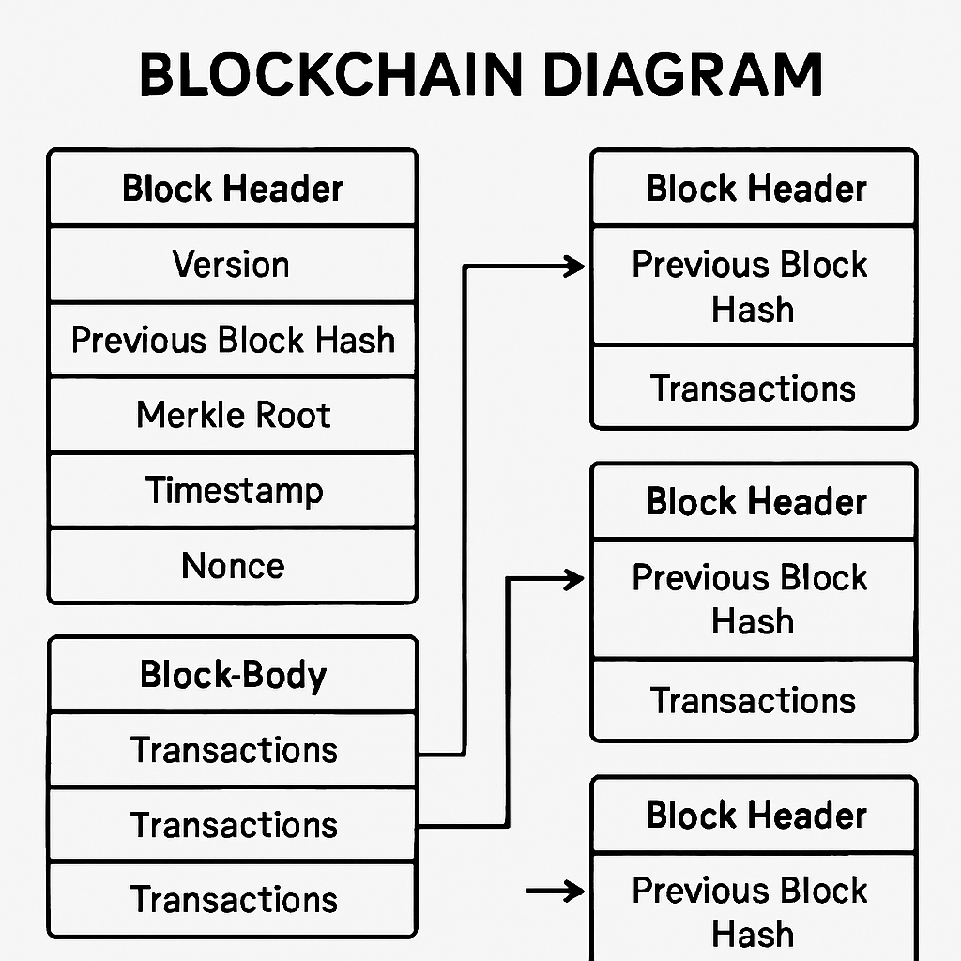
Components of a Block
**Block Header:**
- Version
- Timestamp
- Previous Block Hash
- Merkle Root
- Nonce
- Difficulty Target
**Block Body:**
- List of validated transactions

Slide 6
Block Header in Detail
Version: Blockchain software version
Previous Hash: Links to previous block
Merkle Root: Summary of all transactions
Timestamp: Time of creation
Nonce: Arbitrary number used in mining to find valid hash
Difficulty Target: Mining difficulty

Slide 7
Transaction List (Block Body)
All verified transactions
Includes sender, receiver, amount, signature
Validated before inclusion

Slide 8
Bitcoin Block Structure
Header: Version, Previous Hash, Merkle Root, Timestamp, Difficulty, Nonce.
Body: List of validated transactions.

Slide 9
Difficulty level in Blockchain
The difficulty is a measure of how difficult it is to mine a Bitcoin block, or in more technical terms, to find a hash below a given target.
A high difficulty means that it will take more computing power to mine the same number of blocks, making the network more secure against attacks.
Cryptocurrency difficulty is a parameter that bitcoin and other cryptocurrencies use to keep the average time between blocks steady as the network's hash power changes.
What is the formula for difficulty?
difficulty = difficulty_1_target / current_target
(target is a 256 bit number)
difficulty_1_target can be different for various ways to measure difficulty. Traditionally, it represents a hash where the leading 32 bits are zero and the rest are

Slide 10
Why bitcoin mining difficulty matters
The Bitcoin difficulty algorithm is programmed to keep the entire system stable by maintaining a 10-minute duration for finding new blocks. In essence, it takes roughly 10 minutes for one miner out of the entire network to generate a winning code and win the right to propose a new block of bitcoin transactions to be added to the blockchain.
To maintain this frequency, the algorithm steps in and increases or decreases the difficulty of mining bitcoin. Whenever there’s an influx of miners or mining rigs, it ramps up the difficulty of mining bitcoin. If the reverse is the case (that is, if there is a drop in the number of miners competing to find new blocks), the protocol reduces the mining difficulty to make it easier for the remaining miners to discover blocs. The mining difficulty of the bitcoin network is altered by adding or reducing the zeros at the front of the target hash.
The target hash is the name given to the specific hash (fixed-length code) that all miners are trying to beat. Whoever generates a random code that happens to have an equal or higher number of zeros at the front than the target hash first is selected as the winner.

Slide 11
How frequent is bitcoin mining difficulty adjusted?
Bitcoin’s mining difficulty is updated every 2,016 blocks (or roughly every two weeks). This is why each 2,016 block interval is called the difficulty epoch, as the network determines whether the activities of miners for the last two weeks have reduced or increased the time it takes to mine a new block. If the time it takes is below 10 minutes, the mining difficulty will be increased. The opposite occurs when the block time is above 10 minutes.

Slide 13
Block Creation and Validation
New transactions are grouped into a block.
Block is validated (e.g., via Proof-of-Work or Proof-of-Stake consensus).
Once validated, block is added to the blockchain; all nodes update their copies

Slide 14
Why Block Structure Matters
Security: Tamper-evident record with cryptographic hashes.
Transparency: All participants can see the blockchain.
Decentralization: No single point of control.
Efficiency: Blocks batch multiple transactions for processing

Slide 15
Merkle Tree and Merkle Root
- Efficient verification
- Tamper-proof summary of transactions
- Merkle Root stored in header
[Insert Merkle Tree diagram]

Slide 16
Linking of Blocks
- Hash of previous block in current block
- Forms a secure, immutable chain

Slide 17
Summary
- Block = Header + Transaction List
- Header stores validation data
- Blocks are cryptographically linked

